Slide 1
Automating Database Migrations Tech Lunch & Learn
Ryan Langton & Travis Higgs

Slide 2
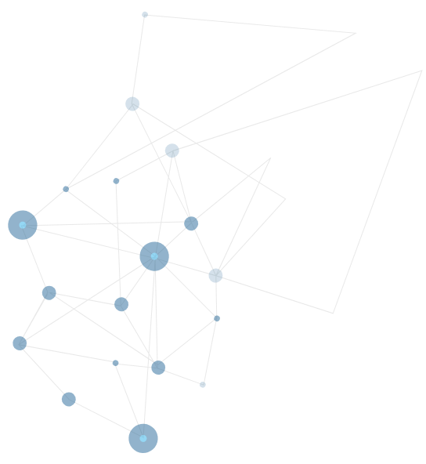

Automating Database Migrations
1
Overview – Why DB migrations?
2
Types of Tooling / Approaches
3
Demo – Entity Framework
4
Demo – Evolve
5
Demo – FluentMigrator
6
Conclusion / Q&A

Slide 3
Overview – database migrations(why/how)

Slide 4


Application changes VS Database changes
Stateless
Code can easily be replaced
Mistakes? Redeploy the app
Stateful
Critical customer data, secure info, etc.
Mistakes? Start looking for a new job

Slide 5
What are database migration tools?
Handles database schema & some data changes (lookups, seed data, etc)
Has a source for detecting schema changes – scripts folder, database project, c# classes, etc
Supports multiple-environments
Can be plugged into CI

Slide 6
Why use tooling for Database Migrations?
Data is important!
1
Repeatable
By automating database changes, we’re able to deploy and test database changes the same way we deploy and test code
2
Source control
Version history of database changes, accountability, and PR scrutiny
3
Code/DB sync
Since our database changes are checked in with the code that uses it, our application code and database schema is always in sync.
4
CI integration
Every step of our application deploy should exist in our CI pipeline
5
Dev friendly
Makes new setups and updates easy

Slide 7
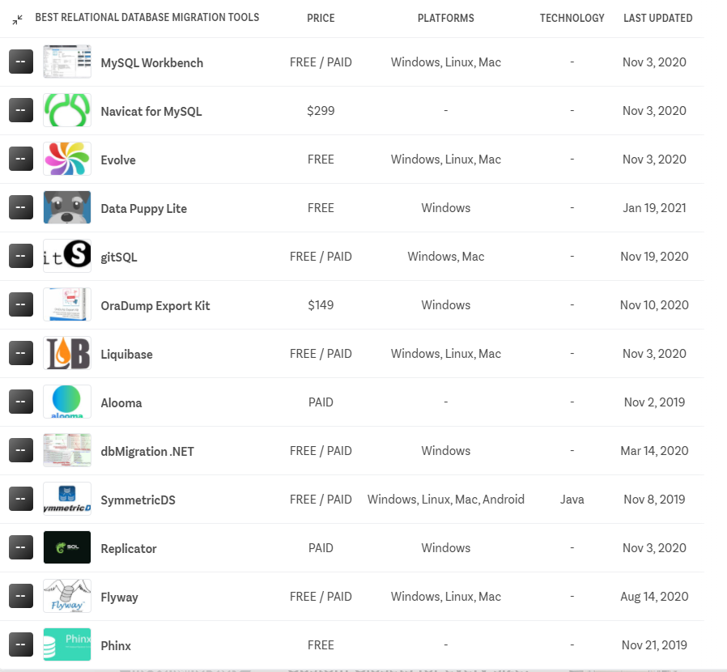
Tooling overload!

Slide 8
How to choose (state-based vs migration based)
State based
Compares source schema to target DB schema and auto-update
Easy to maintain and use but can be problematic with larger databases
Can cause merge issues on large projects, many branches.
Examples: VS SSDT, Redgate SQL, dbForge
Migration based
Uses migrations (sql scripts or source files) to update schema.
Devs must create, verify and test migration scripts (more overhead)
Target DB tracks migration run history
May do a schema compare to help create migrations
More visibility and control as to what is happening
Examples: FluentMigrator, EvolveDB, EntityFramework
Choice: migration based

Slide 9
How to choose (pay vs free/OS)
Pay tools
Often bundled in suites, you may not need the additional tooling.
Support: problems with migrations are like code problems
You don’t call Microsoft support when your .NET code throws an exception, so why would you call support for migrations?
Examples: VS SSDT, Redgate SQL, dbForge
Free migration tools (OS)
Migrations at their core are simple (script automation)
Used successfully in multi-million dollar, heavily regulated production apps (high quality, industry standard)
Examples: FluentMigrator, Evolve, EntityFramework
Choice: Free

Slide 10
Here come the demos!
Entity Framework
Evolve
Fluent Migrator

Slide 11
Evolve

Slide 12

Evolve
Migration based SQL scripts (dbo.changelog)
Simple set up, use, and migrations (low cost to entry)
Placeholders (Environment tokens)
<add key="Evolve.Placeholder.schema1" value="my_schema" />
<add key="Evolve.Placeholder.database" value="my_db" />
SELECT * FROM ${database}.${schema1}.TABLE_1; -- SELECT * FROM my_db.my_schema.TABLE_1;
CI – AppStartup, MSBuild, CLI, or Evolve Tool (.NET Core SDK)
Similar tools – DbUp, RoundhousE
Want to pay $? There’s Flyway (by Redgate)
Demo

Slide 13
Entity Framework

Slide 14
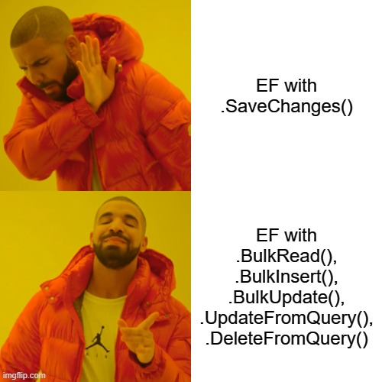
Entity Framework
Microsoft created, supported
Migration based (__EFMigrationsHistory)
Uses code (entity) classes to generate migrations.
Configure using any of the three (or combination)
Attribute ([Key], [ForeignKey], [Required], [MaxLength], etc)
IEntityTypeConfiguration<T>
ModelBuilder startup
Migrations are also code files (inherits from Migration class)
Get environment using .NET DI, IHostEnvironment
if (_hostEnvironment.EnvironmentName != “Production”)
Supports rollback (up/down)
CI – AppStartup or .NET CLI
dotnet ef migradotnet ef migrations script –p <path to your csproj with migrations> -o $(build.artifactstagingdirectory)\migrations\scripts.sql –itions script –p <path to your csproj with migrations> -o $(build.artifactstagingdirectory)\migrations\scripts.sql –i
Demo

Slide 15
FluentMigrator

Slide 16
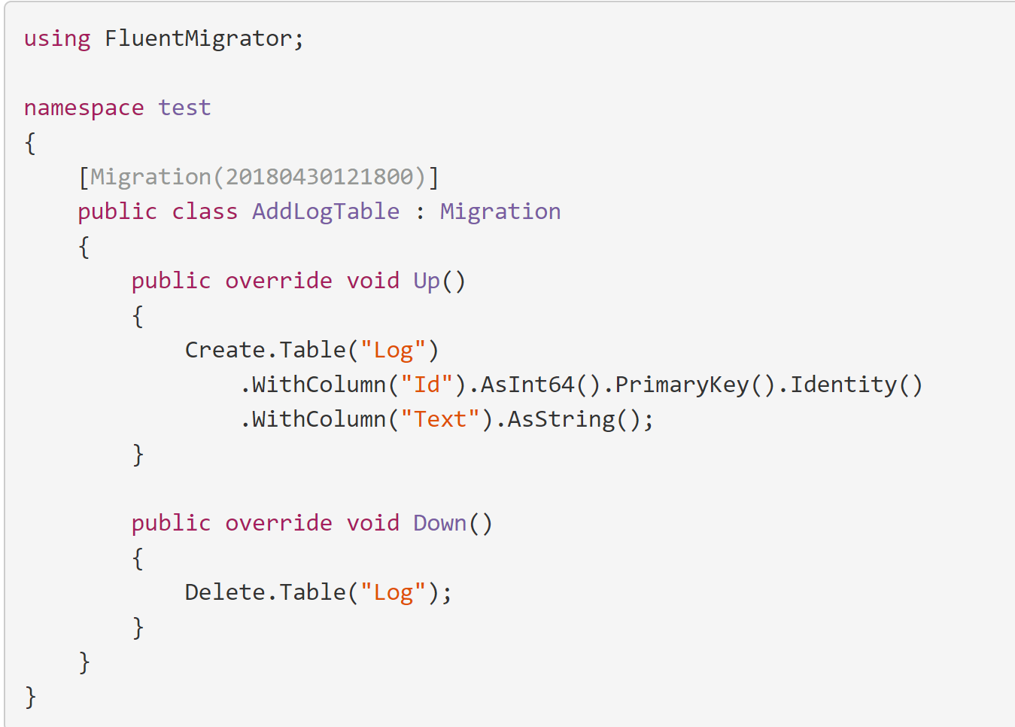
FluentMigrator
.NET Code based migrations (dbo.VersionInfo)
Fluent Syntax and SQL supported
Profiles attributes (environment specific)
[Profile(“Development”)]
Tags for targeted migrations
Supports rollback (up/down)
CI – AppStartup, CLI, or dotnet-fm
Demo

Slide 17
Conclusion

Slide 18


Conclusion
Pick a tool
Automate database migrations
Profit

Slide 19
Q&A

Slide 20
Links
Source code and slides
https://github.com/thiggs-dc/data-migrations
Fluent migrator
https://fluentmigrator.github.io/
Evolve
https://evolve-db.netlify.app/
Entity Framework migrations
https://docs.microsoft.com/en-us/ef/core/managing-schemas/migrations/?tabs=dotnet-core-cli

